Slide 1
Modelling conditional dependence of diagnostic tests for Sepsis in an early economic model
Sara Graziadio¹, Hosein Shabaninejad^{2*}, Gulnar Fattakhova², Ashley Price^{1, 3}, Ben Messer³, Stephen Rice²
1 NIHR Newcastle In Vitro Diagnostics Co-operative
2 Institute of Health & Society (IHS), Newcastle University
3 NuTH (Newcastle Hospitals NHS Foundation Trust)
Notes:
NIHR Newcastle In Vitro Diagnostics Co-operative (NIHR Newcastle MIC)
Collaboration

Slide 2
Introduction: Sepsis
A complex syndrome induced by infection
Mortality rate of 40%
Financial burden on health care (Annual direct costs of £830M)
Increasing risk of mortality for each hour delay in antibiotic administration
Clear need for effective and efficient diagnostic tools to allow early identification and intervention in septic patients
Notes:
Sepsis definition:
Sepsis, a complex syndrome induced by infection, continues to pose a challenge for clinicians (1). In spite of decades of research and efforts to improve treatment of the condition, sepsis still has a published mortality rate of 40% (2). The condition additionally places an enormous financial burden on public health with annual direct costs of £830M and a further £6.9B spent on litigation and productivity expenses (3). Furthermore, with a growing incidence of sepsis cases per year, these figures are only likely to increase in the coming years.
sepsis is not a discrete binary diagnosis but rather a continuum whose gradations are often unclear
SOFA (Sepsis-related Organ Failure Assessment)
systemic inflammatory response syndrome (SIRS)
National Early Warning Score (NEWS)
NEWS includes the assessment of 7 parameters whereas the qSOFA only 3 of the NEWS parameters
(NICE) guidelines NG51

Slide 3
Objective:
Evaluate the minimum combinations of sensitivity and specificity for a diagnostic tool (Mologic test) that allows early diagnosis of sepsis to be cost-saving to the NHS.
Explore (Mologic) test thresholds of sensitivity & specificity for different conditional dependence scenarios.
Notes:
Identify the variables that most influence these combinations
An early economic model was developed for different applications of a test for sepsis to inform hospital admission for patients presenting in an A&E or MAU setting with suspected sepsis (NEWS<5).
The main difference between an early and a full economic evaluation is that the uncertainties are very large in this condition of lack of data.
Very importantly, also the aims of these type of evaluations are different. In the full cost-effectiveness evaluations in a Health Technology Assessment (HTA), for example, the main aim is understanding how likely is that the introduction of a new test/intervention in the current pathway will be cost-effective. The objective of these evaluations are indeed to give indications on adoption to the decision makers and budget holders. The aims of early economic evaluations, instead, is to inform the next phase of the evaluation of the test and, potentially, the technology development (for example giving indications about the price point of the test and the minimum required sensitivity and specificity of the test to be useful/cost-saving).
Since the test has not been fully developed yet, data on its performance and utility are not available, so it is not possible to perform a full economic evaluation.

Slide 4
The economic model structure:
A decision tree was developed in TreeAge, which modelled the outcomes following the use of a Mologic test versus current practice (clinical judgement) to inform hospital admission in following pathways:
1- One test only: Mologic test
2- Two tests in combination: Mologic test with clinical judgement
Conditional dependence between diagnostic tests was also modelled
Outcomes: admission to ward, admission to ICU and Mortality
Outcome data were based on: NHS Scotland data and expert opinion
Notes:
The structure of the model was based on the care pathway diagram. The structure is composed of two main branches: the current pathway and the pathway where the new test was introduced (we will refer to this as the Mologic pathway). The two pathways are identical in structure but the proportions of patients in each branch are different.

Slide 5
Role of the test in this economic analysis:
Possible roles for the new test
Prognostic role (rule in): identify patients who need urgent medical care and require immediate hospital admission from those with signs and symptoms of suspected sepsis
Monitoring/diagnostic role (rule out): identify patients where antibiotics should be stopped
Monitoring/prognostic role: (rule in): identify patients who need to be admitted to ICU or who need to be monitored more frequently
Diagnostic role: (rule in): identify patients who need antibiotics
Focus on prognostic role of the test for patients with a National Early Warning System (NEWS) lower than 5 (patients with NEWS ≥5 are almost always admitted)
Notes:
Test roles: there are these different roles. The test could potentially be used in different roles. Bu the project team, clinical expert opinion identify the rule in prognostic role as one of the more likely cost effective role of the test in terms of informing admission to hospital.
The second role of the test : the majority of clinicians are unlikely to stop antibiotics, especially when the patient is very severe and there are no other options for treatment. In addition there is also an economic argument against this use of the test: all patients are on antibiotics as soon as there is a suspicious of sepsis (if the guidelines are followed). This implies that all patients in the current pathway are treated. If a new test was introduced to stop treatment, considering that no test is perfect, some patients who needed antibiotics would experience the negative consequences of an early interruption of treatment. This is likely to have a significant (negative) impact on patient health and costs to the hospital. It is unlikely that these costs could be balanced by the cost of antibiotics (that is the only additional cost in the current pathway arm of the decision tree) since antibiotics are cheap.
The third option: It would be very unlikely that a decision for ICU admission could be influenced by a test result. They usually decide on the basis of the patient’s conditions, rate of deterioration, patient’s characteristics. They would never leave a patient out of the ICU if they believed that they needed critical care. Even if the ICU was full, they would use the theatres or send the patient to another hospital, but usually there is no need for these drastic decisions. We concluded that the test would not be useful in this context.
The forth role : We excluded this role because by the guidelines all patients with a suspicious of sepsis should have antibiotics straight away, so a test in this context won’t be very useful.
The first option: There may be a point in developing a test within this context for patients who have a NEWS lower than 5. In this population clinicians might be more positive at the idea of waiting to administer antibiotics since the risk of sudden deterioration is lower and the time to wait for a result is not too high.
we evaluated the test used as a prognostics to reduce trainee doctor uncertainty around the decision concerning hospital admissions in a population of patients with suspected sepsis and NEWS lower than 5.

Slide 6
Results: One test
Different (Mologic) test cost scenarios:
Possible Scenarios | Test Cost (£) | Prior probability of admission | Base-case Sen/Spec (Current Practice) | Reference Sen/Spec Test value | Sen threshold test | Spec threshold
Scenario 1 (one test) | 3 | 0.26 | 0.96/0.93 | 0.98 | 0.93 | 0.92
Scenario 2 (one test) | 6 | 0.26 | 0.96/0.93 | 0.98 | 0.94 | 0.94
Scenario 3 (one test) | 10 | 0.26 | 0.96/0.93 | 0.98 | 0.96 | 0.96
Different prevalence scenarios:
Possible Scenarios | Test Cost (£) | Prior probability of admission | Base-case Sen/Spec (Current Practice) | Reference Sen/Spec Test value | Sen threshold | Spec threshold
Scenario 4 (one test) | 10 | 0.15 | 0.92/0.97 | 0.98 | 0.98 | 0.98
Scenario 5 (one test) | 10 | 0.45 | 0.98/0.91 | 0.98 | 0.94 | 0.87

Slide 7
Combined tests decision rules:
Description of parallel test decision rules
Overall positive result (admission): OR (++, +-, -+)
Overall negative result (discharge): AND (--)
Description of sequential test decision rules
Overall positive result (admission): AND (++)
Overall negative result (discharge): OR (--, -+, +-)
Example of parallel test conditional dependence

Slide 8
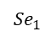
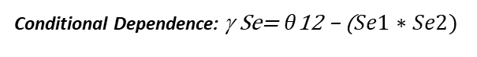
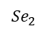
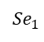
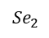
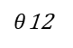
Conditional Dependence Parallel; Sn (OR):
Explore Sensitivity threshold for different conditional dependence scenarios for the Mologic test
people with the disease
people with the disease
$${Se}_{1}$$
$${Se}_{1}$$
$${Se}_{2}$$
$${Se}_{2}$$
$θ$12
Se1: sensitivity of Clinical judgement Se2: sensitivity of Mologic test
Se1: sensitivity of Clinical judgement Se2: sensitivity of Mologic test
Conditional Dependence: γ Se= $θ$12 – ($Se1∗Se2)$
$\text{joint} \text{OR} \text{sensitivity} =1−\left(1−Se1\right)\left(1−Se2\right)−$γ Se
Notes:
Use of two tests
Possible alternatives:
Parallel approach (OR for Sensitivity, AND for Specificity)
Sequential approach (AND for Sensitivity, OR for Specificity)

Slide 9
Results; Two tests (Parallel):
Test results for conditional dependence 0.35 and no conditional dependence over different prevalence for parallel testing
Possible Scenarios | Test Cost (£) | Prior probability of admission | Base-case Sen/Spec (Current Practice) | Reference Sen/Spec Test value | Sen threshold | Spec threshold
Scenario 6 (Two test), Parallel No Conditional dependence | 3 | 0.26 | 0.96/0.93 | 0.98 | 0.72 | 0.97
Scenario 7 (Two test), Parallel Conditional dependence (0.35) ) | 3 | 0.26 | 0.96/0.93 | 0.98 | 0.92 | 0.96
Scenario 8 (Two test), Parallel Conditional dependence (0.35) ) | 3 | 0.4 | 0.96/0.93 | 0.98 | 0.86 | 0.92
Notes:
Positive dependence reduce the sensitivity of parallel test interpretation. (As above table shows, with correlation we need a higher level of threshold for the test sensitivity to be cost effective in combined tests sensitivity parallel interpretation. In the other words, with dependence, the sensitivity decrease and we need a higher level of sensitivity threshold for the test to achieve a desirable threshold for sensitivity to be cost-effective in parallel approach. Moreover, as prevalence increase sensitivity, with increasing prevalence (from 0.26 to 0.4), again we need a lower level of threshold for the test for being cost-effective.

Slide 10
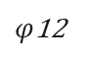
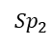
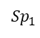
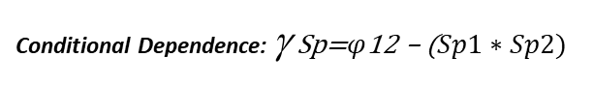
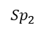
Conditional Dependence Parallel; Sp (AND)
Explore specificity threshold for different conditional dependence scenarios for the Mologic test
people without the disease
people without the disease
$${Sp}_{1}$$
$${Sp}_{2}$$
$${Sp}_{1}$$
$${Sp}_{2}$$
$φ$12
Sp1: Specificity of Clinical judgement Sp2: Specificity of Mologic test
Sp1: Specificity of Clinical judgement Sp2: Specificity of Mologic test
Conditional Dependence: γ Sp=$φ$12 – ($Sp1∗Sp2)$
$$\text{joint} \text{OR} \text{specificity}=Sp1∗Sp2+\text{γ }\text{Sp}$$

Slide 11
Results; Two tests (Parallel)
Test results for conditional dependence 0.35 and no conditional dependence over different prevalence for parallel testing
Possible Scenarios | Test Cost (£) | Prior probability of admission | Base-case Sen/Spec (Current Practice) | Reference Sen/Spec Test value | Sen threshold | Spec threshold
Scenario 6 (Two test), Parallel No Conditional dependence | 3 | 0.26 | 0.96/0.93 | 0.98 | 0.72 | 0.97
Scenario 7 (Two test), Parallel Conditional dependence (0.35) ) | 3 | 0.26 | 0.96/0.93 | 0.98 | 0.92 | 0.96
Scenario 8 (Two test), Parallel Conditional dependence (0.35) ) | 3 | 0.4 | 0.96/0.93 | 0.98 | 0.86 | 0.92
Notes:
Positive dependence reduce the sensitivity of parallel test interpretation. (As above table shows, with correlation we need a higher level of threshold for the test sensitivity to be cost effective in combined tests sensitivity parallel interpretation. In the other words, with dependence, the sensitivity decrease and we need a higher level of sensitivity threshold for the test to achieve a desirable threshold for sensitivity to be cost-effective in parallel approach. Moreover, as prevalence increase sensitivity, with increasing prevalence (from 0.26 to 0.4), again we need a lower level of threshold for the test for being cost-effective.

Slide 12
Results; Two tests (Sequential)
Test results for conditional dependence 0.35 and no conditional dependence over different prevalence for sequential testing
Possible Scenarios | Test Cost (£) | Prior probability of admission | Base-case Sen/Spec (Current Practice) | Reference Sen/Spec Test value | Sen threshold | Spec threshold
Scenario 9 (Two test), Sequential No Conditional dependence | 3 | 0.26 | 0.96/0.93 | 0.98 | 0.95 | 0.52
Scenario 10 (Two test), Sequential Conditional dependence (0.35) | 3 | 0.26 | 0.96/0.93 | 0.98 | 0.95 | 0.84
Scenario 11 (Two test) Conditional dependence (0.35) | 3 | 0.4 | 0.96/0.93 | 0.98 | 0.97 | 0.91
Notes:
Positive dependence in test specificity reduces the specificity of serial interpretation. (As above table shows, with correlation we need a higher level of threshold for the test specificity to be cost effective in combined tests specificity sequential interpretation. In the other words, with dependence, the specificity decrease and we need a higher level of specificity threshold for the test to achieve a desirable threshold for specificity to be cost-effective in sequential approach. Moreover, as prevalence decrease specificity, with increasing prevalence (from 0.26 to 0.4), again we need a higher level of threshold for the test for being cost-effective.

Slide 13
Discussion:
If the application of the test is in parallel combination with clinical judgement, positive dependence has a significant effect on the sensitivity threshold.
If the application of the test is in serial combination with clinical judgement, positive dependence has a significant effect on the specificity threshold.
Notes:
In comparison with using test alone (0.93 sensitivity, 0.92 specificity), parallel approach provides lower level sensitivity threshold (0.72), while sequential approach provides lower level specificity threshold (0.52)
Using test alone in compare with using test with clinical opinion, there is a difference if parallel approach (the Specificity threshold is lower; 0.96 vs 0.92) and sequential (the sensitivity threshold is lower 0.95 vs 0.92)
If the application of the test is in parallel combination with clinical judgement, the magnitude of the conditional dependence between clinical judgement and the test has a significant effect on the threshold sensitivity but not on the specificity
If the application of the test is in serial combination with clinical judgement, the magnitude of the conditional dependence between clinical judgement and the test has a significant effect on the threshold specificity but not on the sensitivity
Positive dependence reduce the sensitivity of parallel test interpretation. As table shows, with correlation we need a higher level of threshold for the test sensitivity to be cost saving in combined tests sensitivity parallel interpretation
Positive dependence in test specificity reduces the specificity of serial interpretation. (As table shows, with correlation we need a higher level of threshold for the test specificity to be cost saving in combined tests specificity sequential interpretation.

Slide 14
Discussion:
The base case estimates of sensitivity and specificity of expert opinion used in current practice are high
0,96 and 0.93 for sensitivity and specificity respectively
Consequently, prognostic accuracy estimates are correspondingly high.
Notes:
Expert opinion uncertainty makes a 0.9 combined test sensitivity and specificity to be cost saving
It is far less likely that this would be possible for a target of 0.8 test sensitivity and specificity to be cost saving
Given the relatively low expected cost savings associated with improved sensitivity and specificity, any time savings associated with the use of the test in the admission/discharge decision process will have a significant effect.
However, there is no evidence on time savings. A lower prior probability of admission also makes specificity relatively more important than sensitivity, which changes the required values.

Slide 15

The End

Slide 16
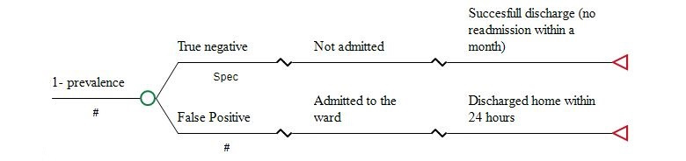
The economic model structure:
Notes:
For the patients who are at low risk of sepsis (Low risk SOS- let’s consider this as the “true” condition of the patient), there are two options.
They can be correctly classified by the test (Mologic pathway) or by the clinician (current pathway); in this case they are considered True Negatives (TN) and are discharged home from the A&E.
Otherwise they are False Positives (FP) that implies that they were incorrectly classified as “high risk SOS”. In this case they are admitted to the ward and discharged home within 24 hours (model assumption).
If the patient instead is considered at high risk of sepsis, they can be admitted (True positives, TP) or discharged home (False Negatives, FN).
In the latter case they re-present to the hospital within 5 days and are admitted (model assumption).
They then follow the same path as the TPs.
If a patient is considered at high risk for SOS, they can be admitted to ICU or die in the ward or being discharged home.
Each discharge home after admission can be successful (no return to the hospital within a month) or unsuccessful (readmission within a month was needed). If they were admitted to the ICU they can die in ICU or being discharged home.

Slide 17
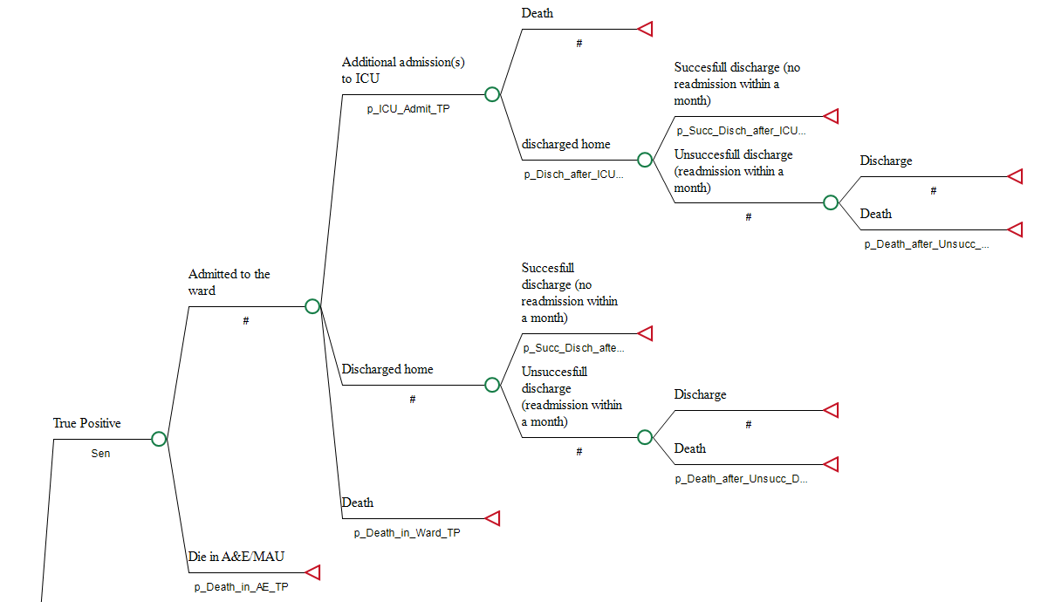
The economic model structure
Notes:
For the patients who are at low risk of sepsis (Low risk SOS- let’s consider this as the “true” condition of the patient), there are two options.
They can be correctly classified by the test (Mologic pathway) or by the clinician (current pathway); in this case they are considered True Negatives (TN) and are discharged home from the A&E.
Otherwise they are False Positives (FP) that implies that they were incorrectly classified as “high risk SOS”. In this case they are admitted to the ward and discharged home within 24 hours (model assumption).
If the patient instead is considered at high risk of sepsis, they can be admitted (True positives, TP) or discharged home (False Negatives, FN).
In the latter case they re-present to the hospital within 5 days and are admitted (model assumption).
They then follow the same path as the TPs.
If a patient is considered at high risk for SOS, they can be admitted to ICU or die in the ward or being discharged home.
Each discharge home after admission can be successful (no return to the hospital within a month) or unsuccessful (readmission within a month was needed). If they were admitted to the ICU they can die in ICU or being discharged home.

Slide 18
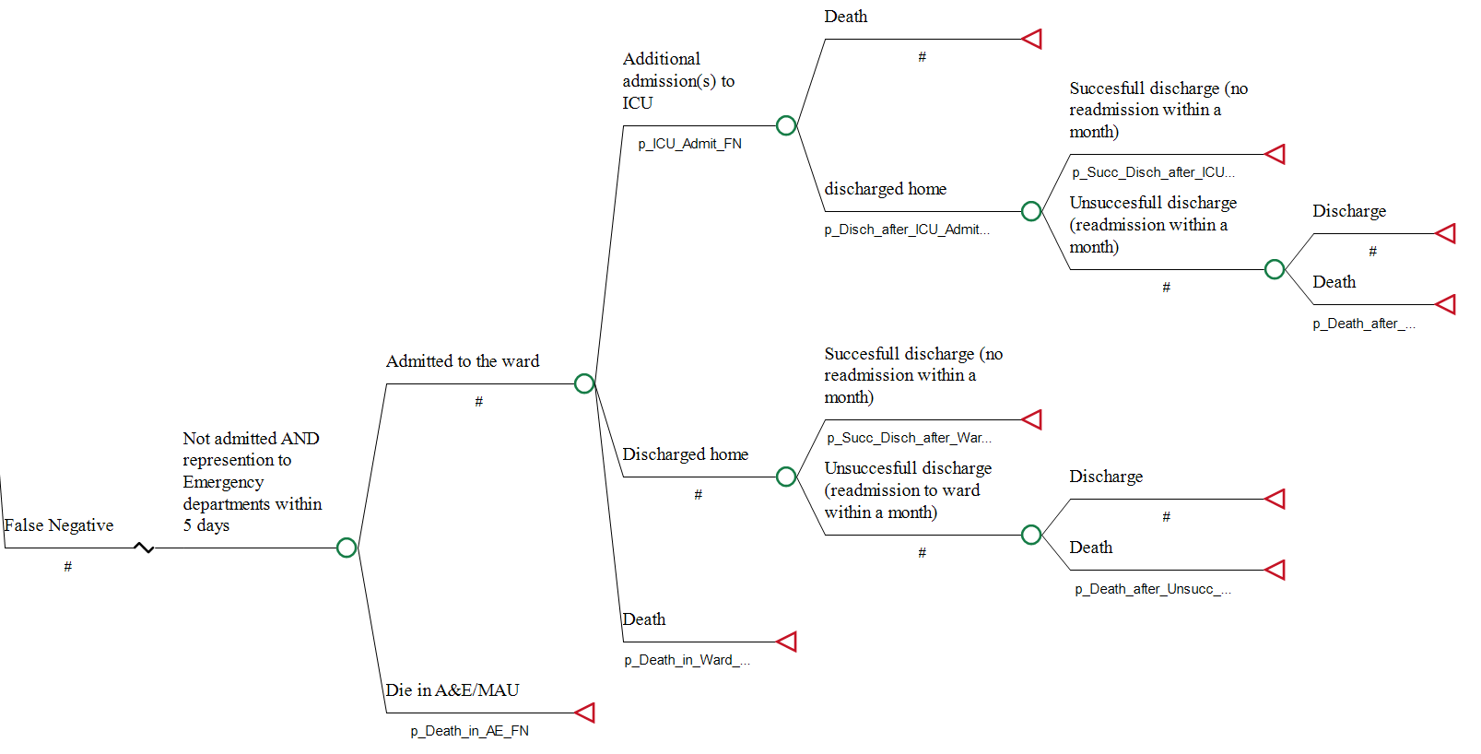
The economic model structure
Notes:
For the patients who are at low risk of sepsis (Low risk SOS- let’s consider this as the “true” condition of the patient), there are two options.
They can be correctly classified by the test (Mologic pathway) or by the clinician (current pathway); in this case they are considered True Negatives (TN) and are discharged home from the A&E.
Otherwise they are False Positives (FP) that implies that they were incorrectly classified as “high risk SOS”. In this case they are admitted to the ward and discharged home within 24 hours (model assumption).
If the patient instead is considered at high risk of sepsis, they can be admitted (True positives, TP) or discharged home (False Negatives, FN).
In the latter case they re-present to the hospital within 5 days and are admitted (model assumption).
They then follow the same path as the TPs.
If a patient is considered at high risk for SOS, they can be admitted to ICU or die in the ward or being discharged home.
Each discharge home after admission can be successful (no return to the hospital within a month) or unsuccessful (readmission within a month was needed). If they were admitted to the ICU they can die in ICU or being discharged home.

Slide 19
Key parameters for sensitivity analysis
The cost of the test (Registrar time saved) (3, 6, 10)
Prevalence (0.1, 0.26, 0.4)

Slide 20
The model parameters
No | Parameters | Value
1 | Cost of Antibiotic for patient: discharged from hospital/ admitted in ICU/ admitted in Ward | 3 /256/67
2 | Cost of admission in ICU (for TP/FN) | LOS*Unit Cost
3 | Cost of admission in Ward (TP/FP/FN) | LOS*Unit cost
4 | Cost of readmission | Expected cost of TP admitted to hospital
5 | Proportion of Death in A&E (TP/FN) | 0.02
6 | Cost of Mologic Test/Clinical Opinion | 10/0
7 | Proportion of Death after Unsuccessful Discharge ICU (FN/TP) | Expected probability of dying for TP
8 | Proportion of Death after Unsuccessful Discharge ward (FN/TP) | Expected probability of dying for TP
9 | Proportion of Death in ICU (TP/FN) | (0.16/0.23)
10 | Proportion of Death in the Ward (TP/FN) | 0.07
11 | Proportion of Discharge after admission to Ward (TP/FN) | (0.9/0.881)
12 | Proportion of Discharge after ICU Admission (TP/FN) | 0.77
13 | Proportion of ICU Admission(TP/FN) | (0.03, 0.049)
14 | Proportions of re-admissions vs patients admitted (ward) (TP/FN) | (0.05, 0.06)
15 | Proportions of re-admissions vs patients admitted (ICU only) (TP/FN) | (0.05/0.1)
16 | Successful Discharge after ICU admission | 0.86
17 | Successful Discharge after Ward admission | 0.93
18 | Prevalence (Disease) | 0.26
19 | Sensitivity of the Test | Range in sensitivity analysis
20 | Specificity of the Test | Range in sensitivity analysis
21 | Sensitivity of the Current practice | 0.96
22 | Specificity of the Current practice | 0.93
23 | Correlation assumed | 0.35

